Slide 1
Bibliographic Resources for Bioinformatics and Genome Analyses
Fredj Tekaia
tekaia@pasteur.fr
Bioinformatics and Genome Analyses
Institut Pasteur Tunis, Tunisia. September 18 – December 15, 2017

Slide 2
Plan
• Main scientific journals
• Scientific work evaluation
• News groups

Slide 3
• Bibliography is essential in research activities
• Researchers should keep tract of the flow of scientific works that are regularly published
• This task is facilitated today by the online availability of scientific journals.
Here we will show links to some significant journals publishing Bioinformatics and Genome Research Activities.

Slide 4
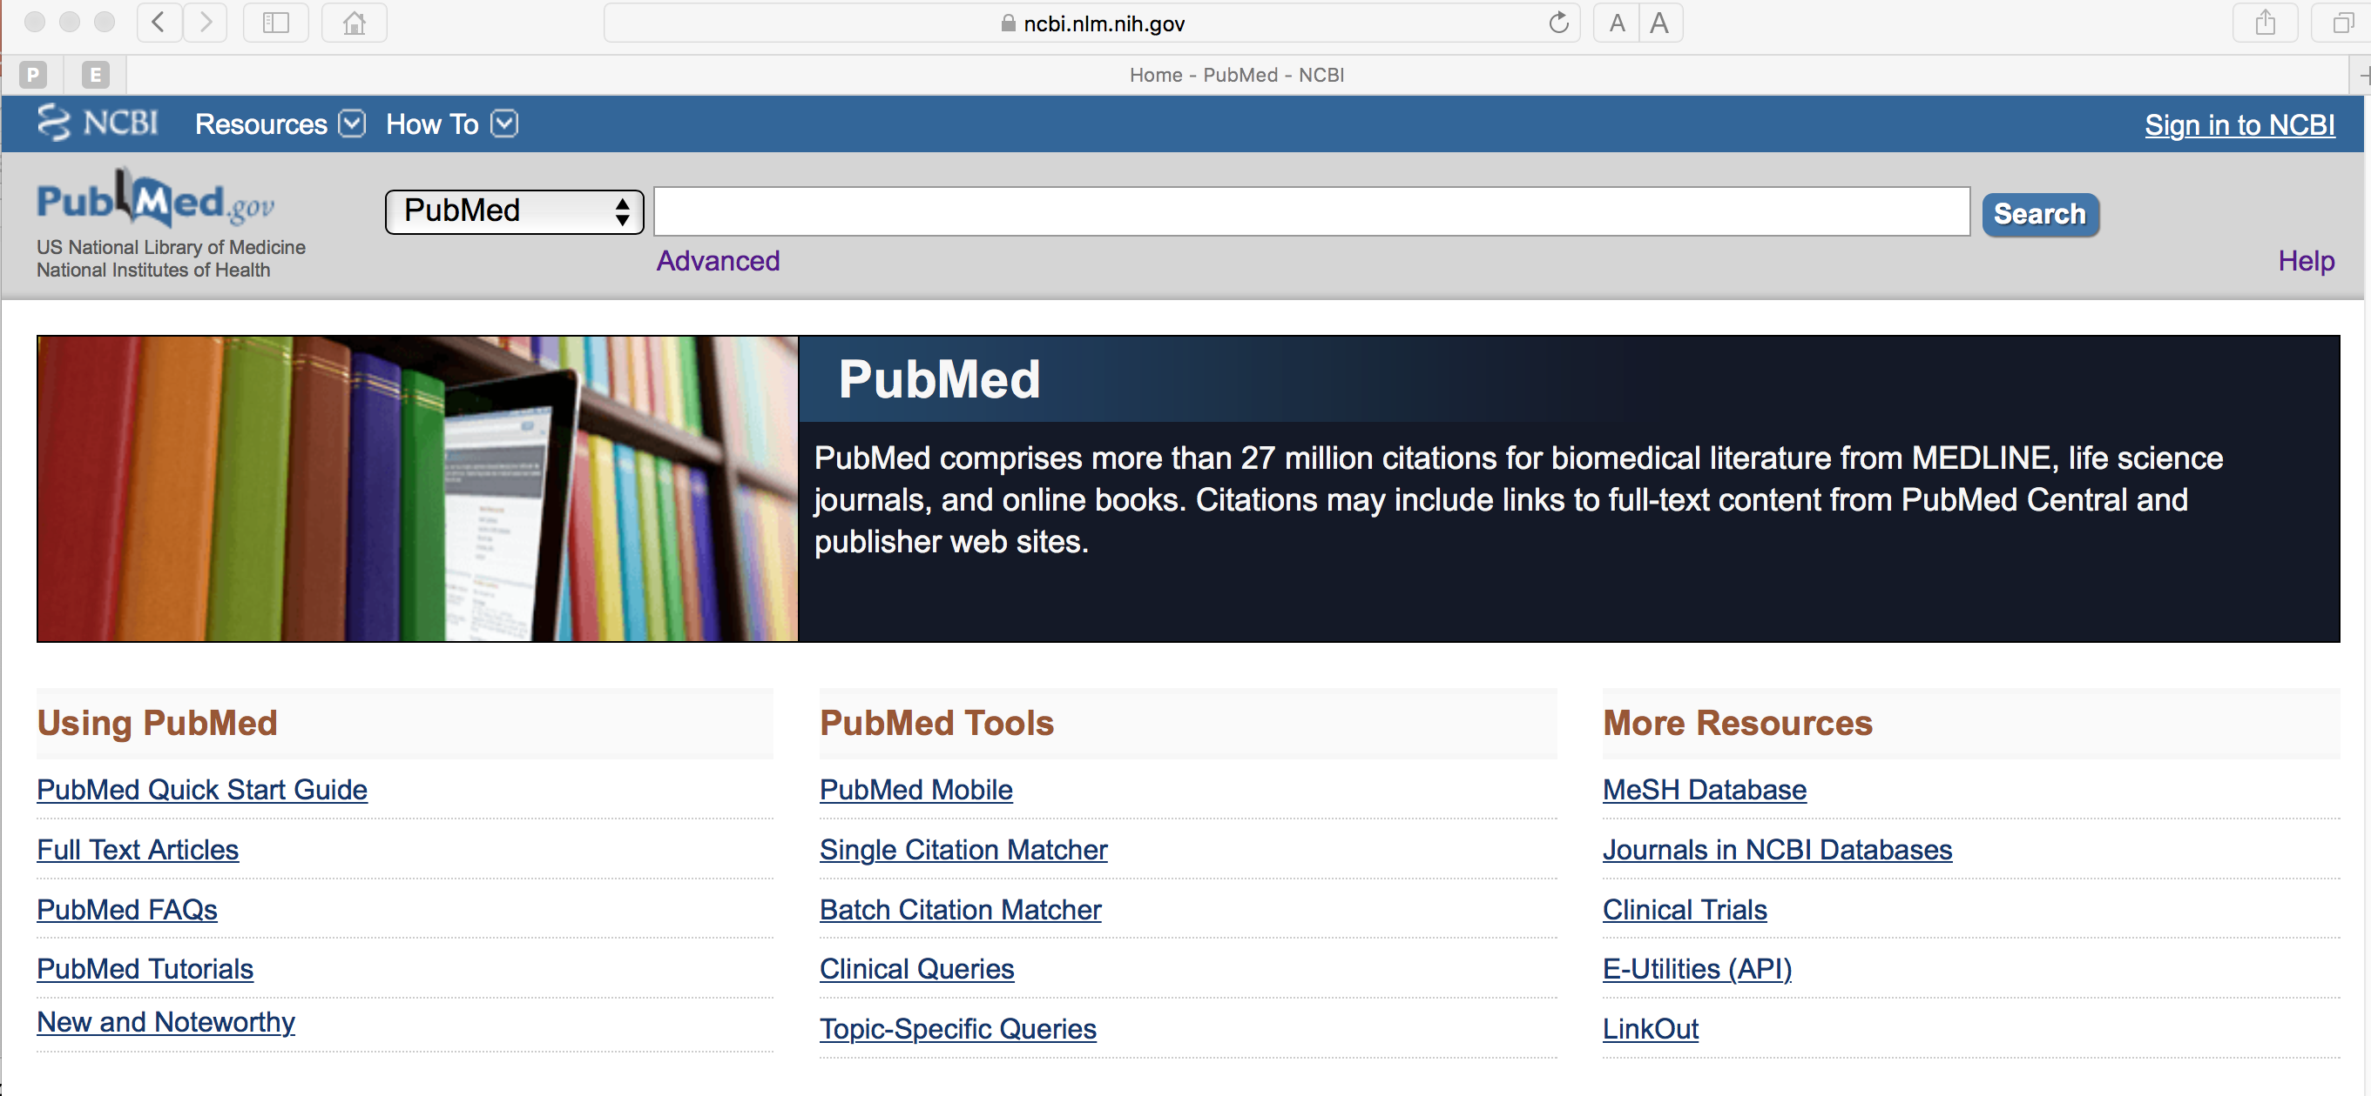
The easiest way is:
PubMed (@ncbi):
http://www.ncbi.nlm.nih.gov/pubmed/
Abstracts and full papers.

Slide 5
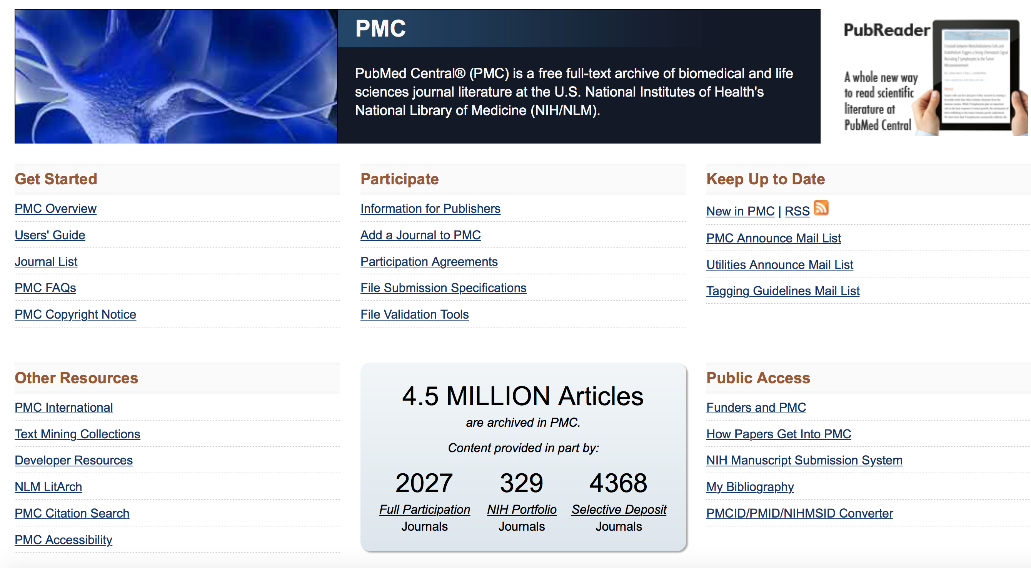
PubMed Central: A free archive of life sciences journals:
http://www.ncbi.nlm.nih.gov/pmc/

Slide 6
Journals
(paper & electronic forms)
"Sign in" to receive regularly Table Of Contents (TOC)

Slide 7

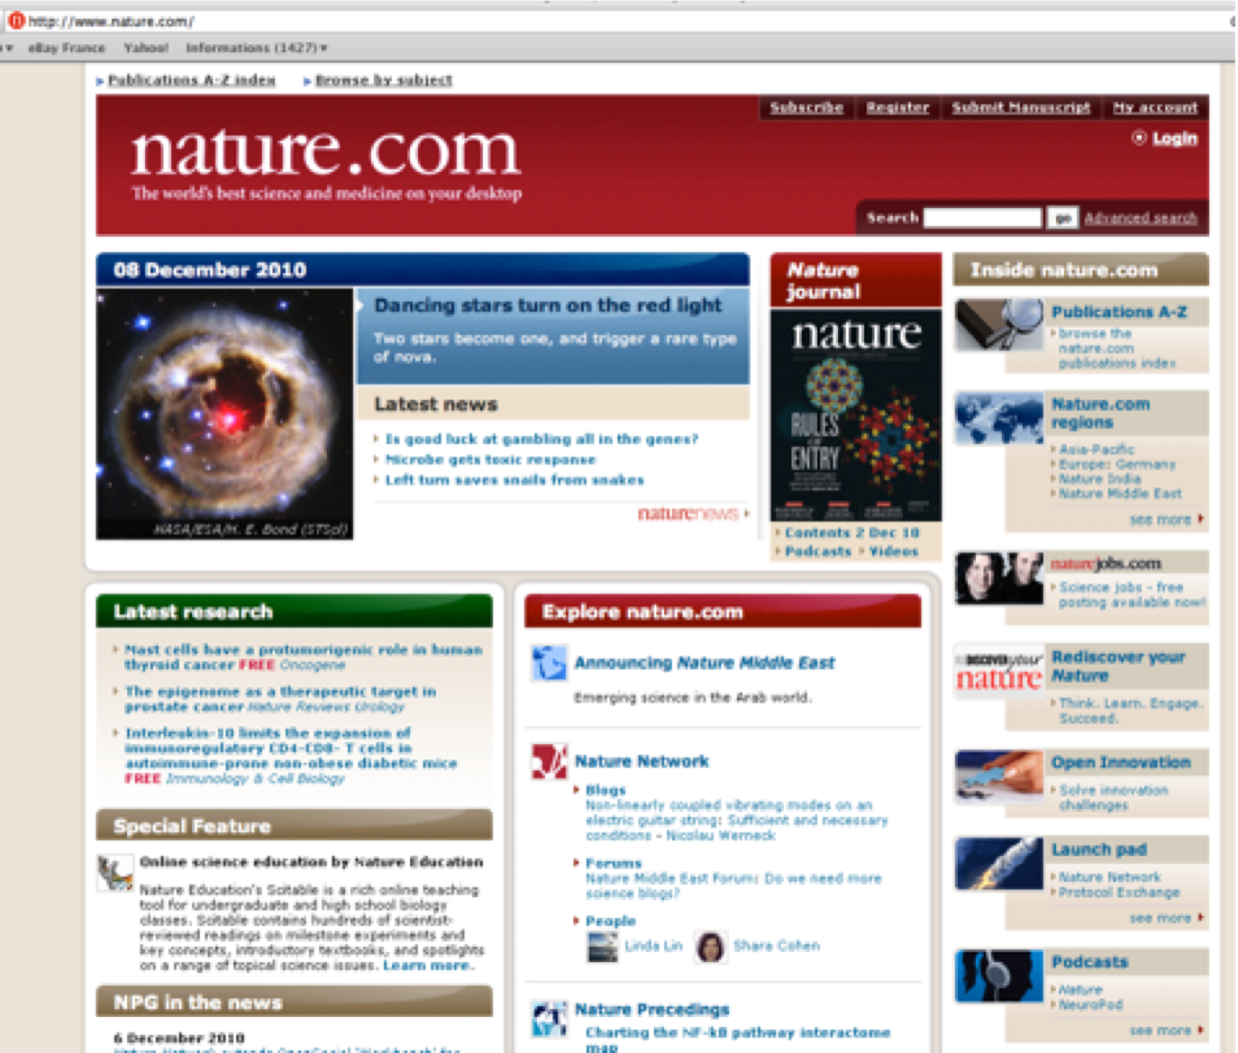
http://www.nature.com/

Slide 8
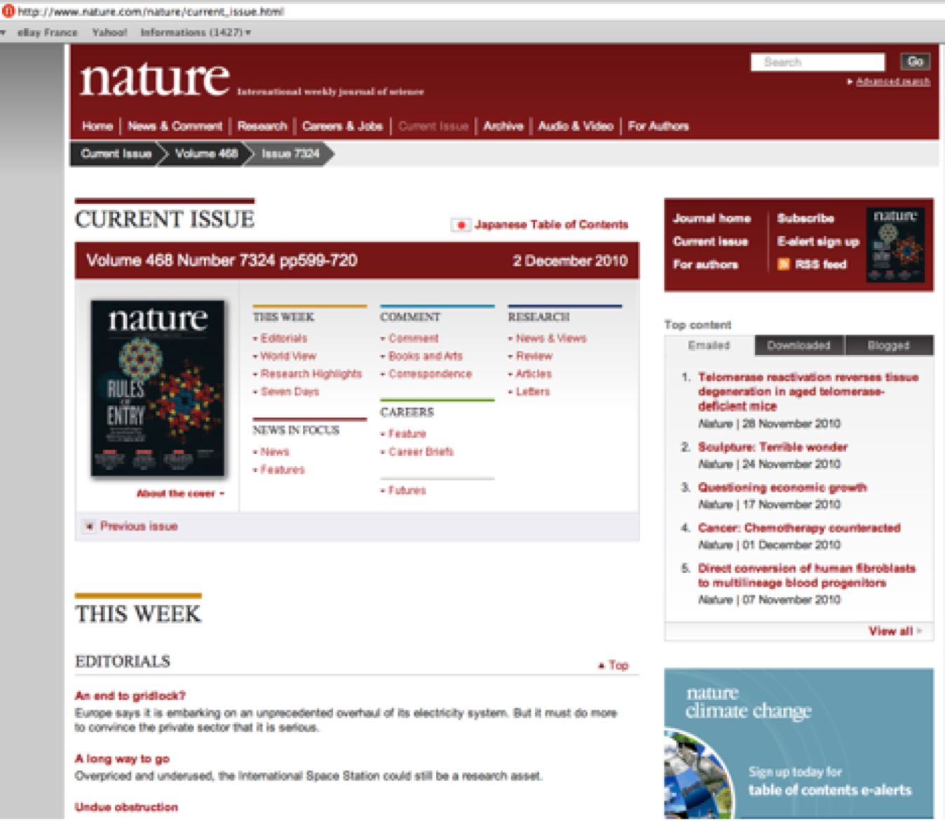
http://www.nature.com/nature/current_issue.html
Each Thursday

Slide 9

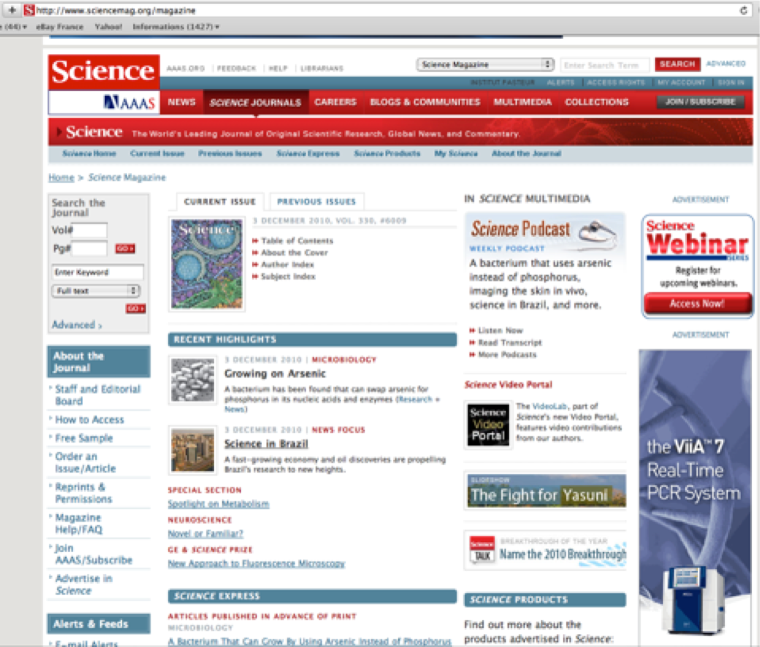
http://www.sciencemag.org/magazine
Each Friday

Slide 10
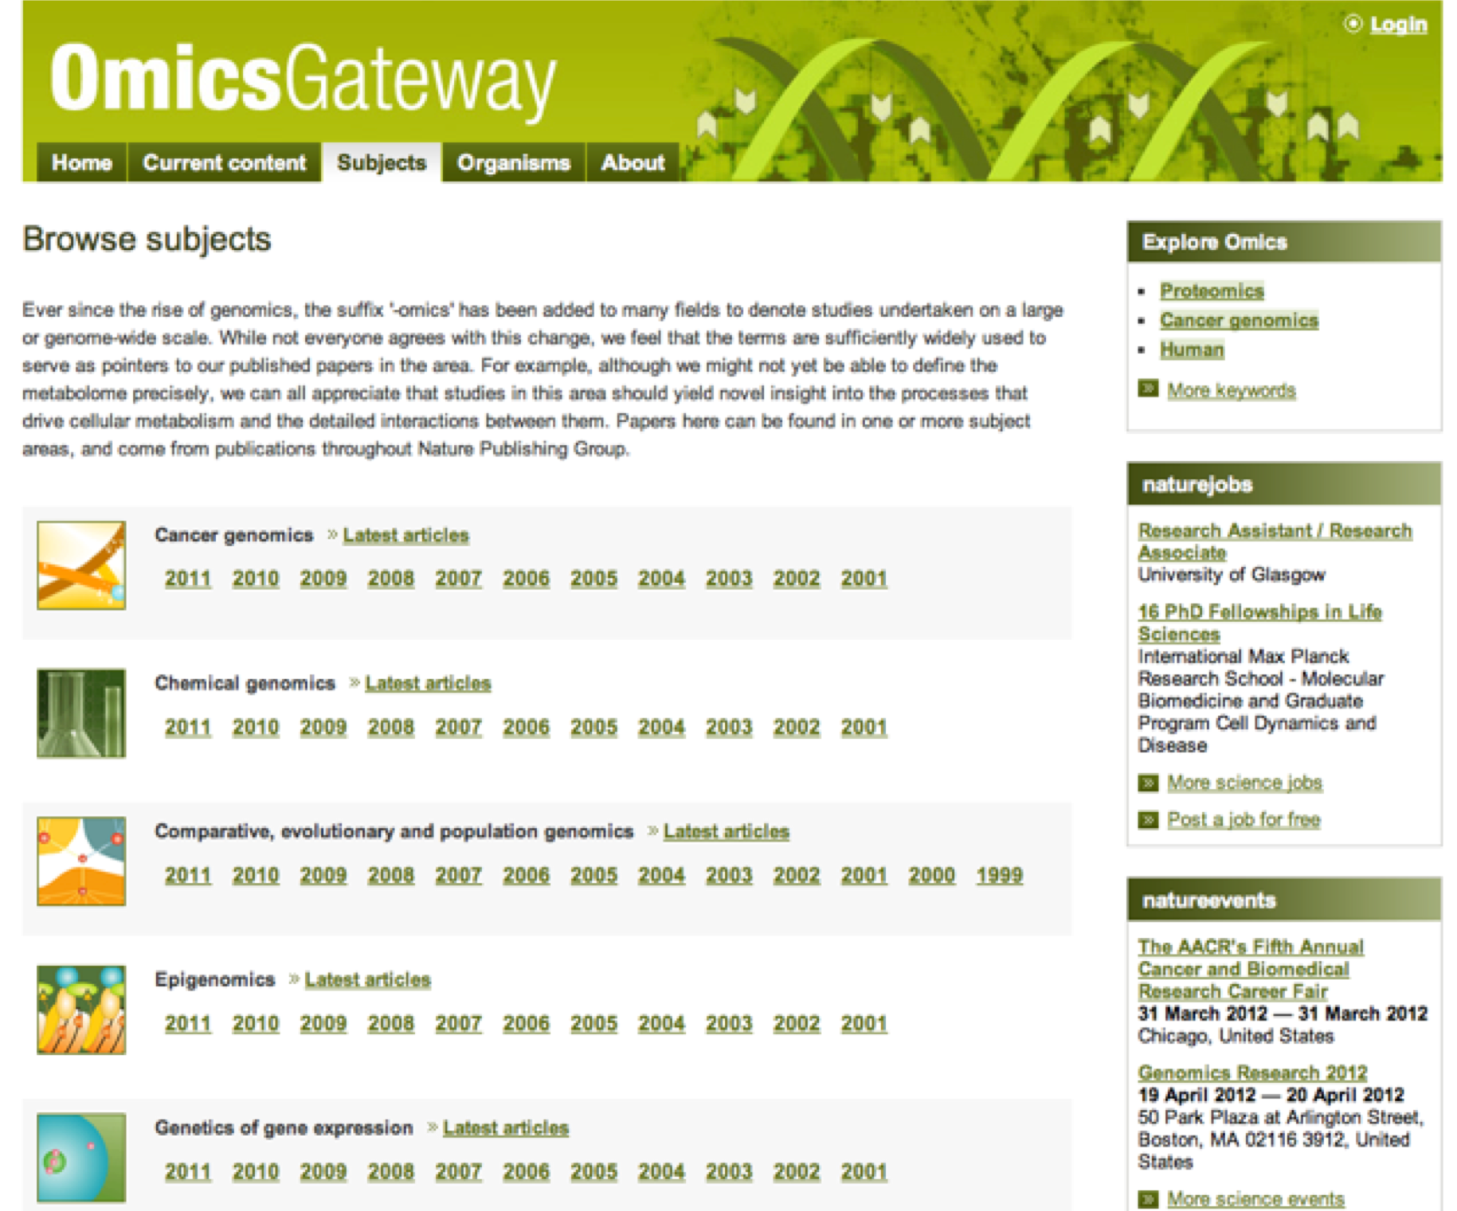
nature Omics Gateway: http://www.nature.com/omics/subjects/index.html

Slide 11
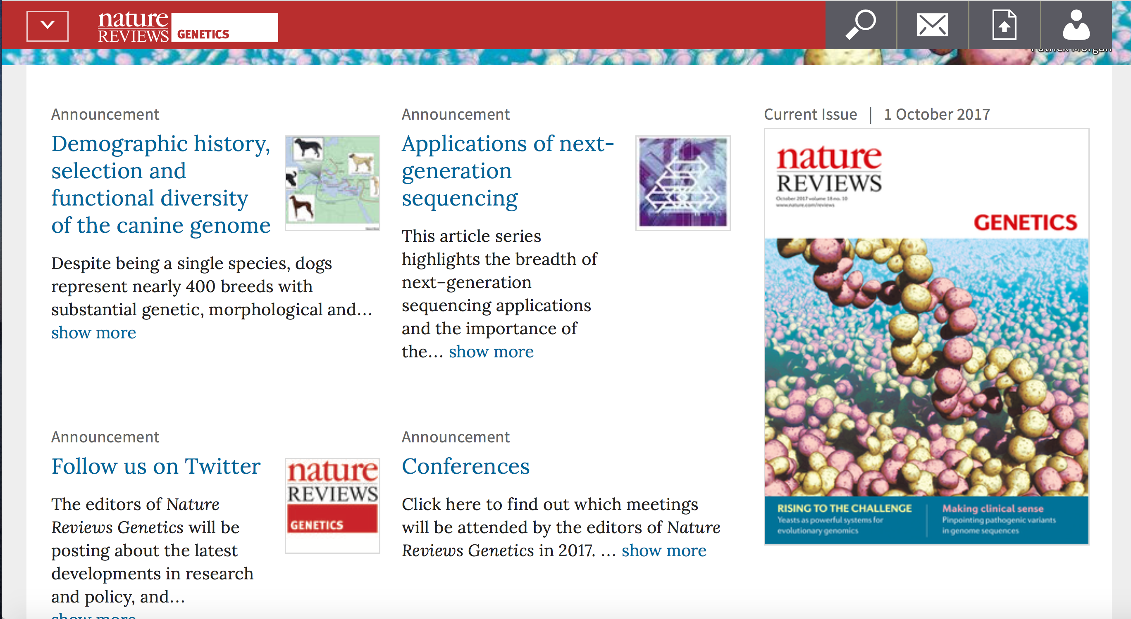
http://www.nature.com/nrg/index.html
http://www.nature.com/nrg/series/nextgeneration/index.html
https://www.nature.com/nrg/about/conferences

Slide 12

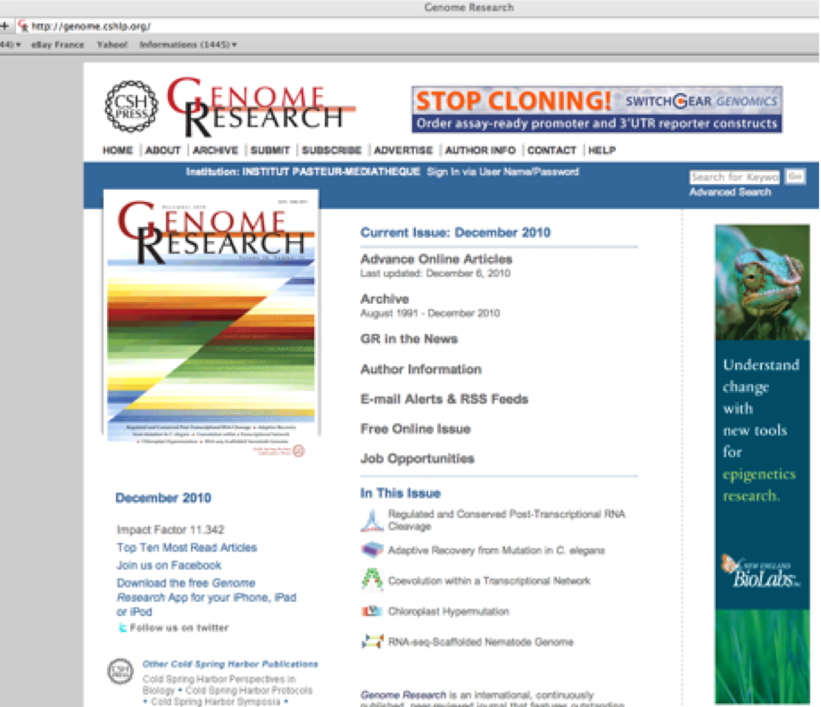
http://genome.cshlp.org/

Slide 13
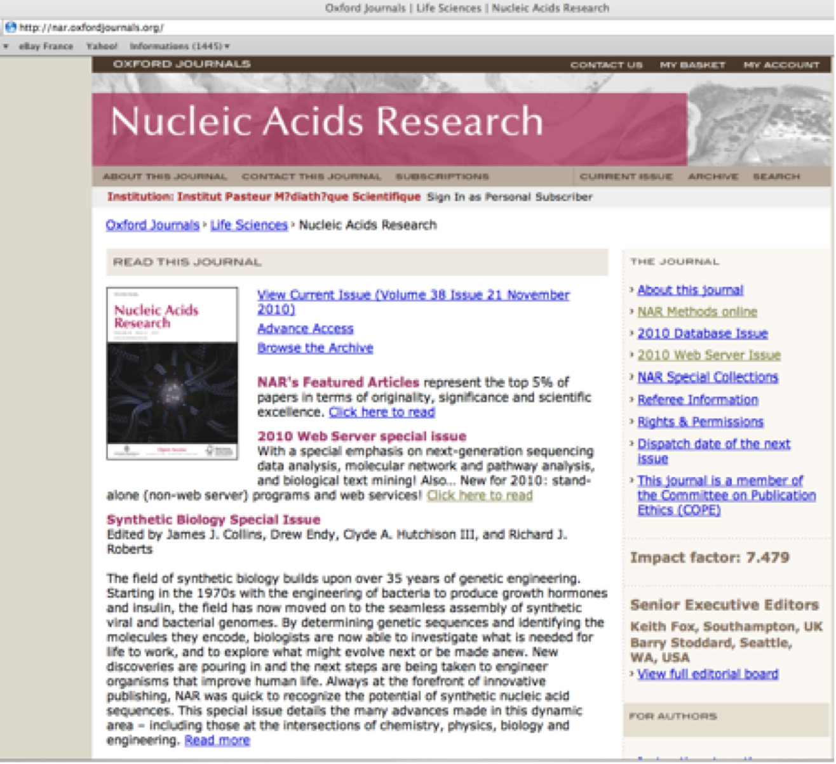
NAR: http://nar.oxfordjournals.org/

Slide 14

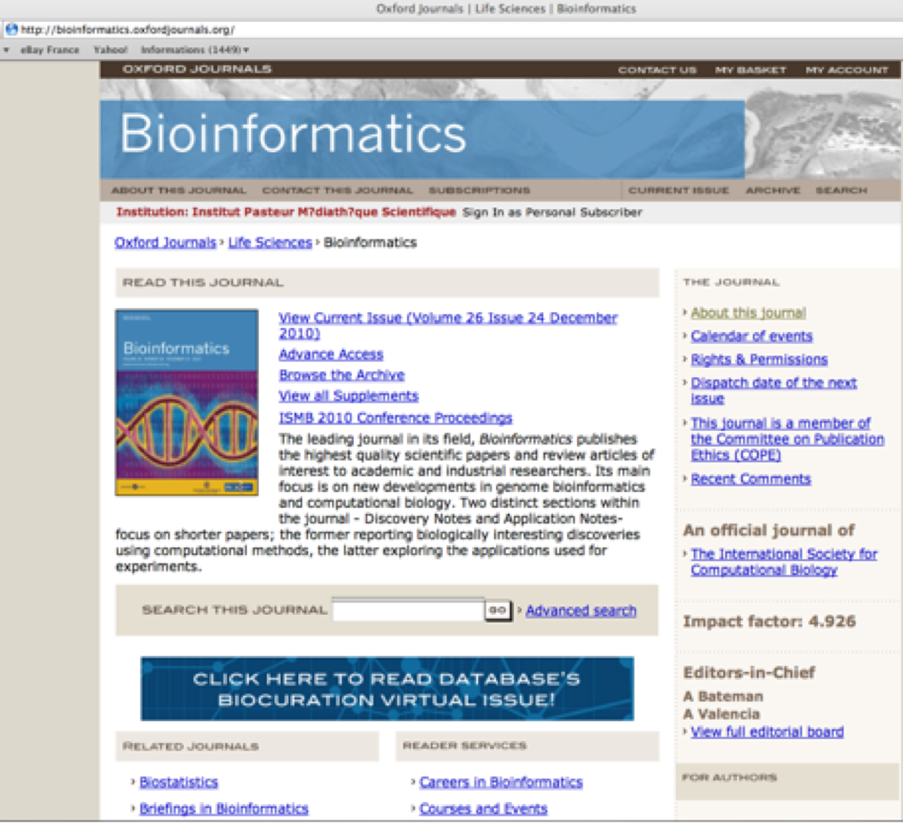
http://bioinformatics.oxfordjournals.org/

Slide 15
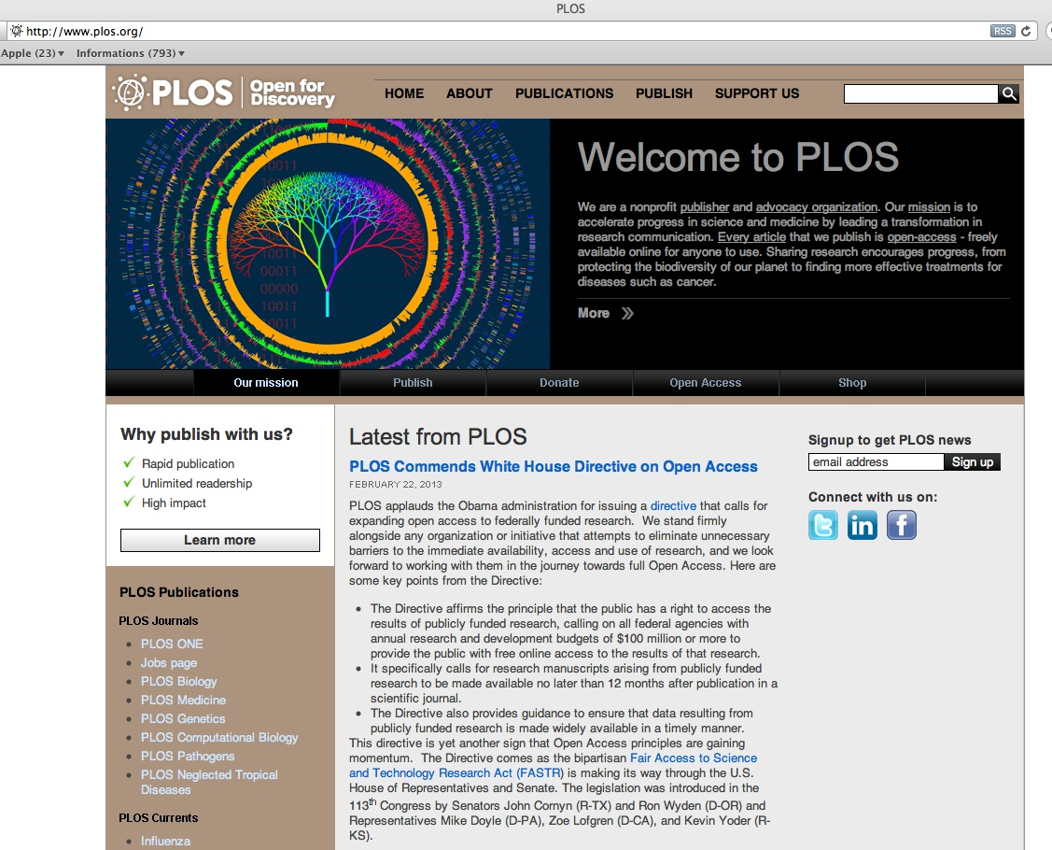

Slide 16




Plos journals:
Plos Biology: http://www.plosbiology.org/home.action
Plos genetics: http://www.plosgenetics.org/home.action
Plos Computational Biology: http://www.ploscompbiol.org/home.action
Ten simple Rules collection:
http://www.ploscollections.org/article/browseIssue.action?issue=info%3Adoi%2F10.1371%2Fissue.pcol.v03.i01

Slide 17
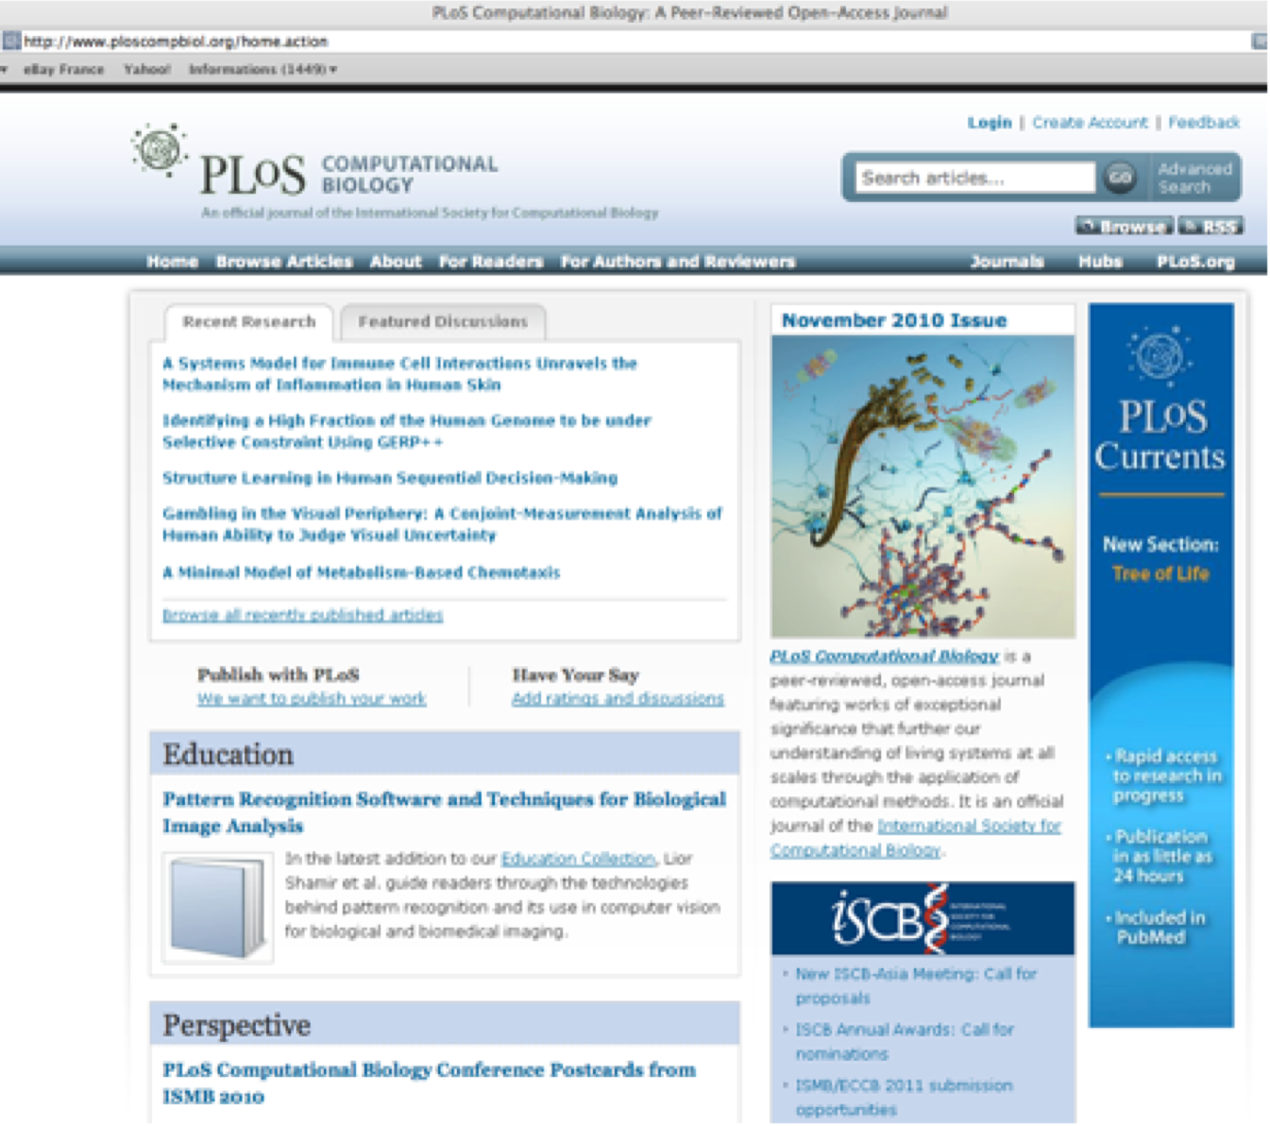
http://www.ploscompbiol.org/home.action

Slide 18





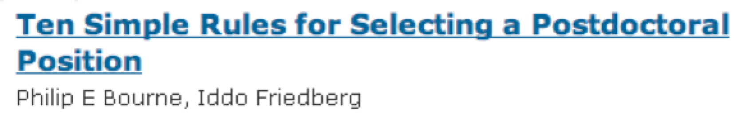


Ten simple rules: http://www.ploscompbiol.org/

Slide 19
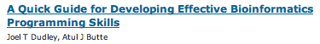
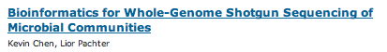


Some guiding papers on Bioinformatics:
http://www.ploscompbiol.org/

Slide 20





http://www.biomedcentral.com/journals/
https://bmcgenomics.biomedcentral.com

Slide 21
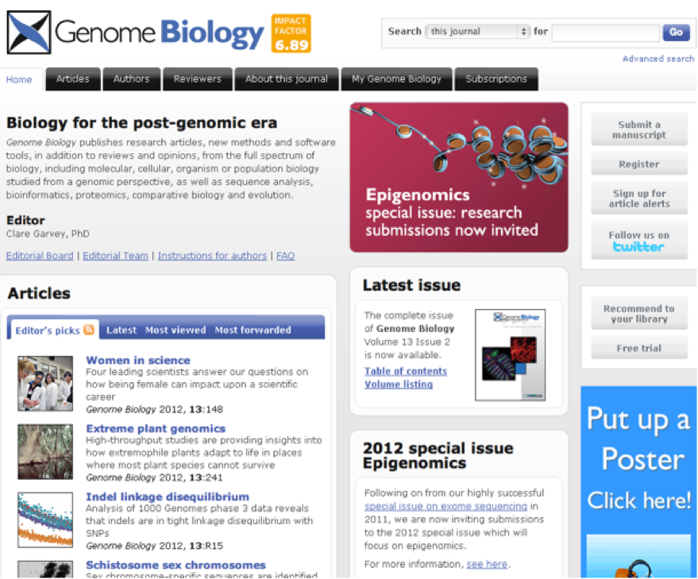
http://genomebiology.com/

Slide 22
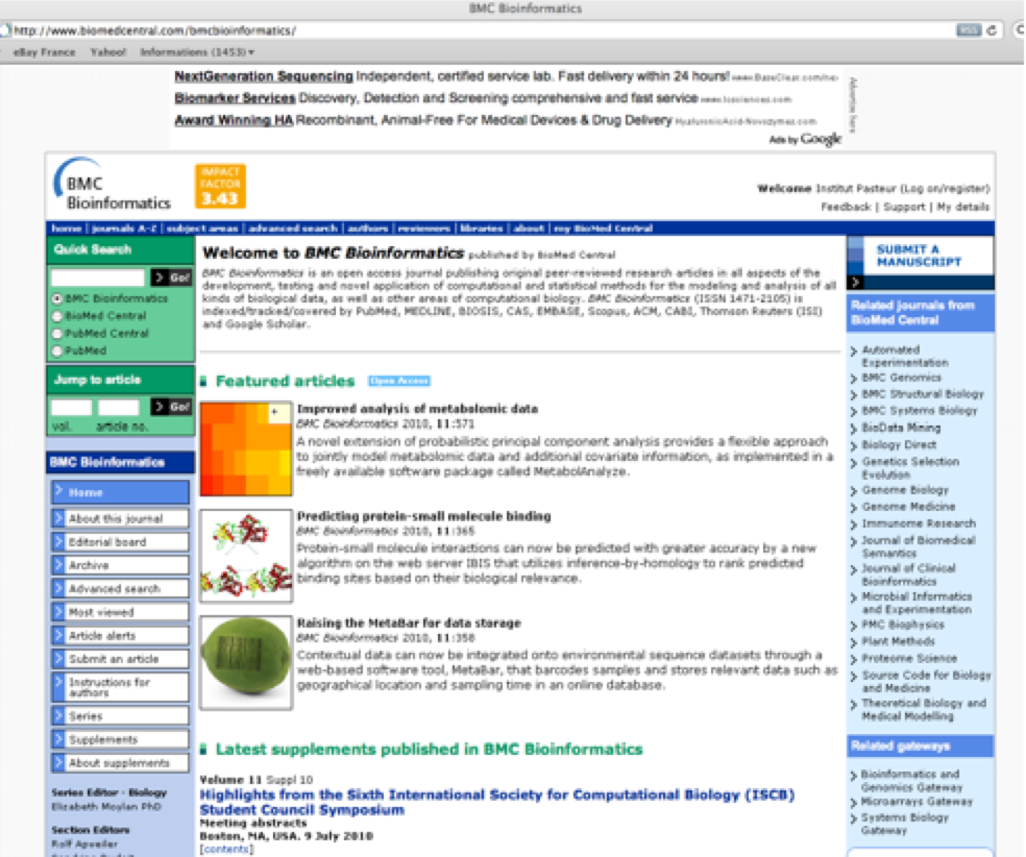
http://www.biomedcentral.com/bmcbioinformatics/

Slide 23
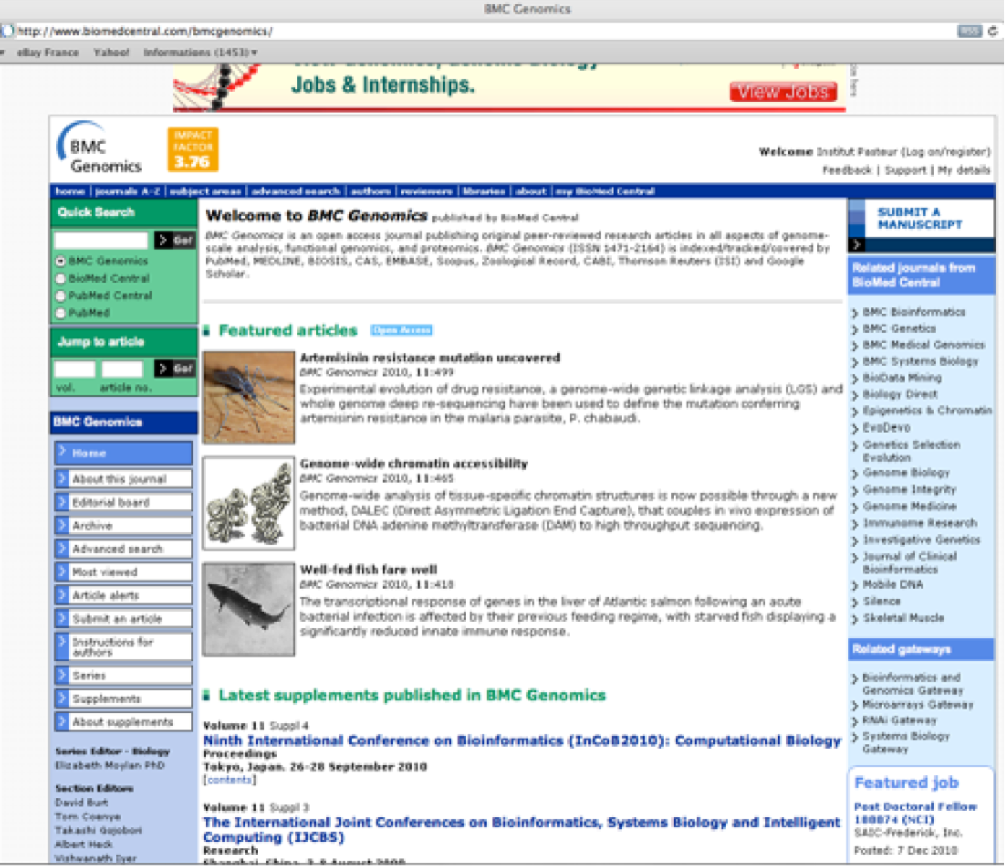
http://www.biomedcentral.com/bmcgenomics/

Slide 24
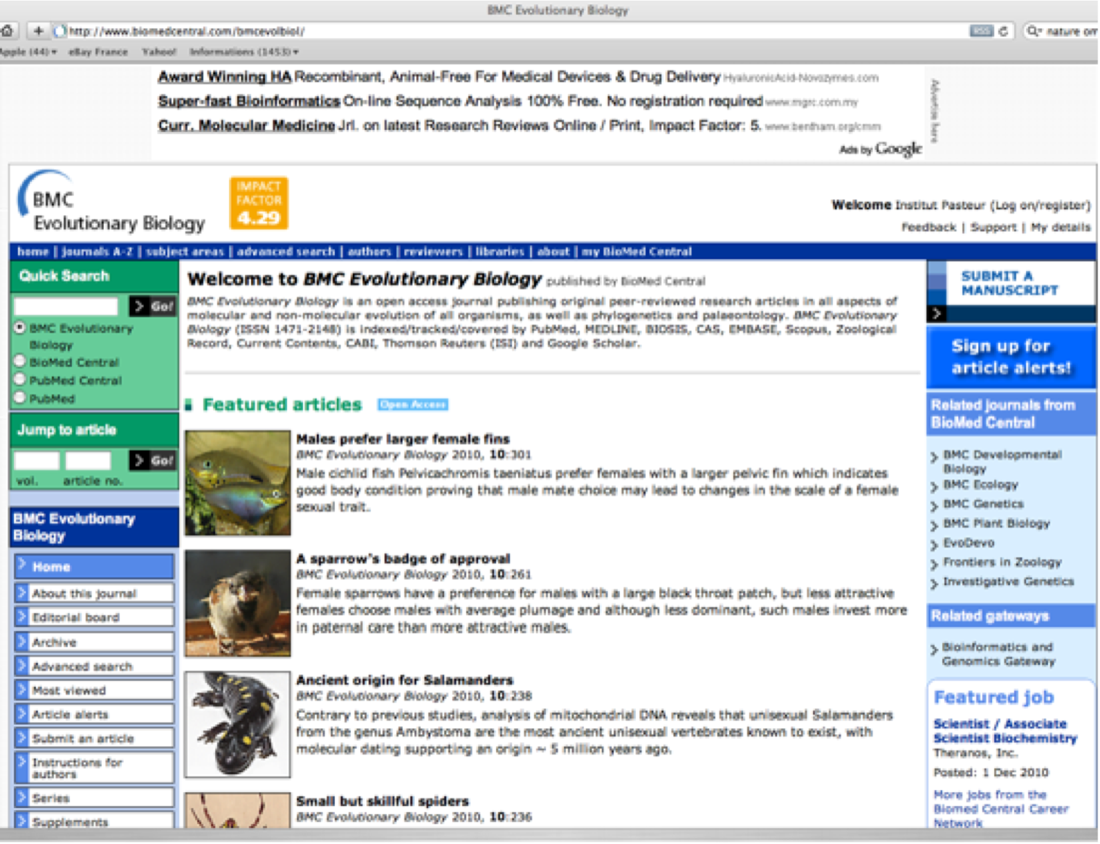
http://www.biomedcentral.com/bmcevolbiol/

Slide 25

http://genomea.asm.org/

Slide 26
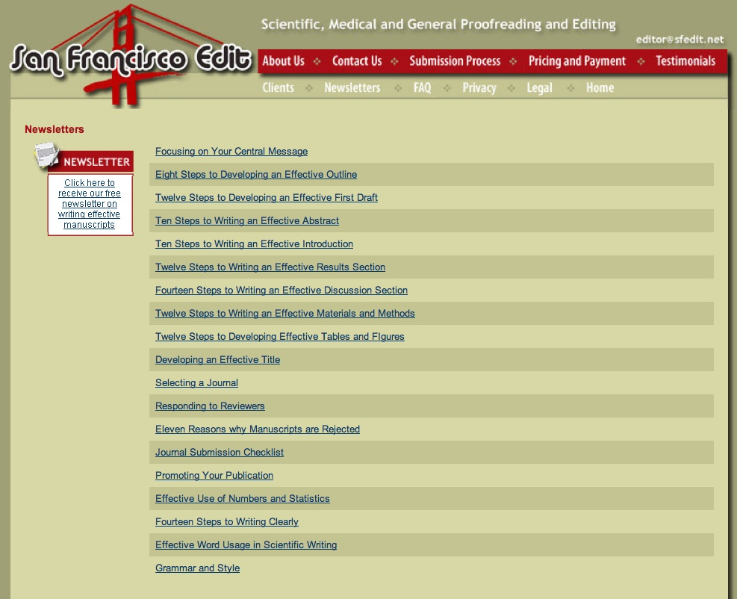
http://www.sfedit.net/newsletters.htm

Slide 27
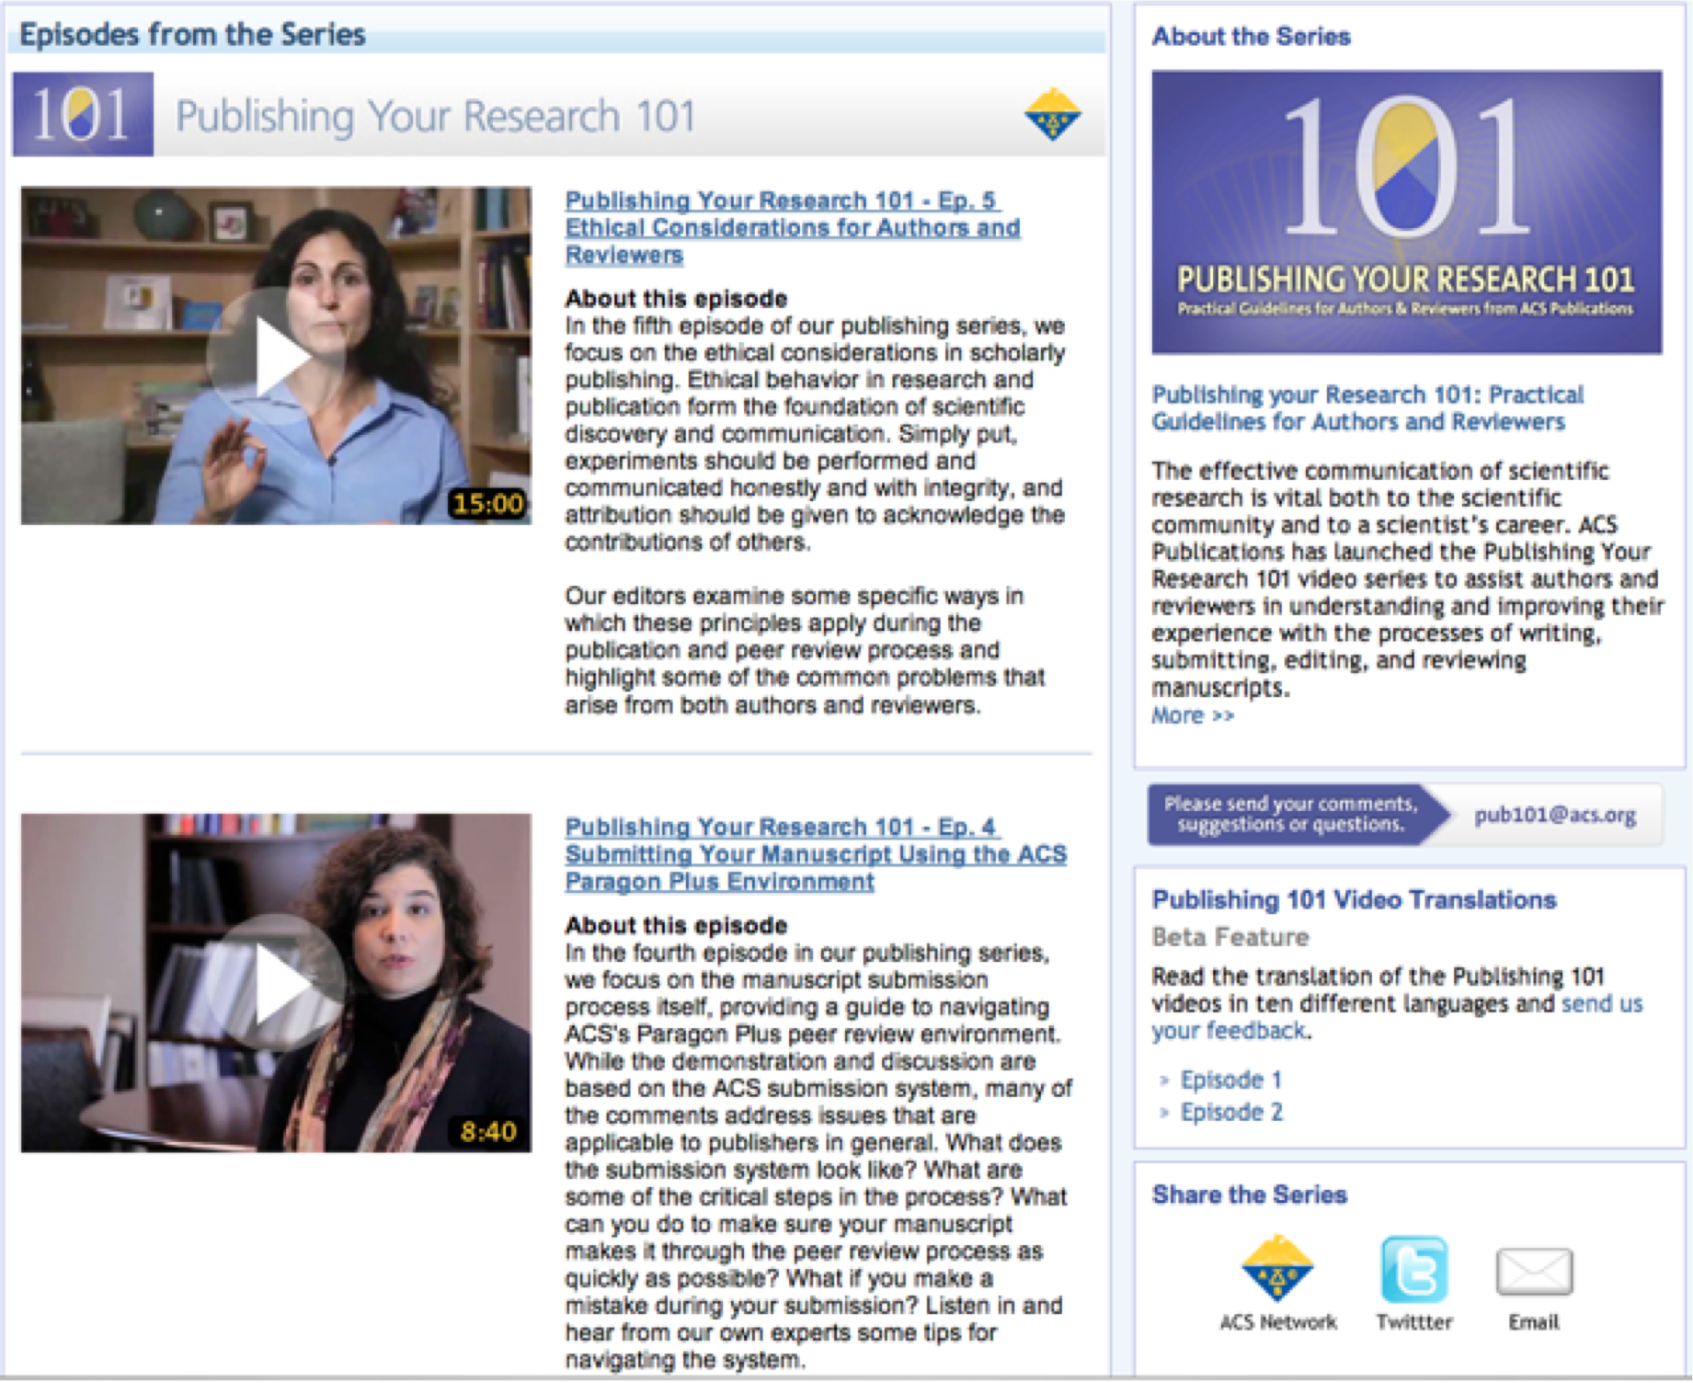
Publishing your Scientific Research
ACS Publications:
http://pubs.acs.org/page/publish-research/index.html

Slide 28
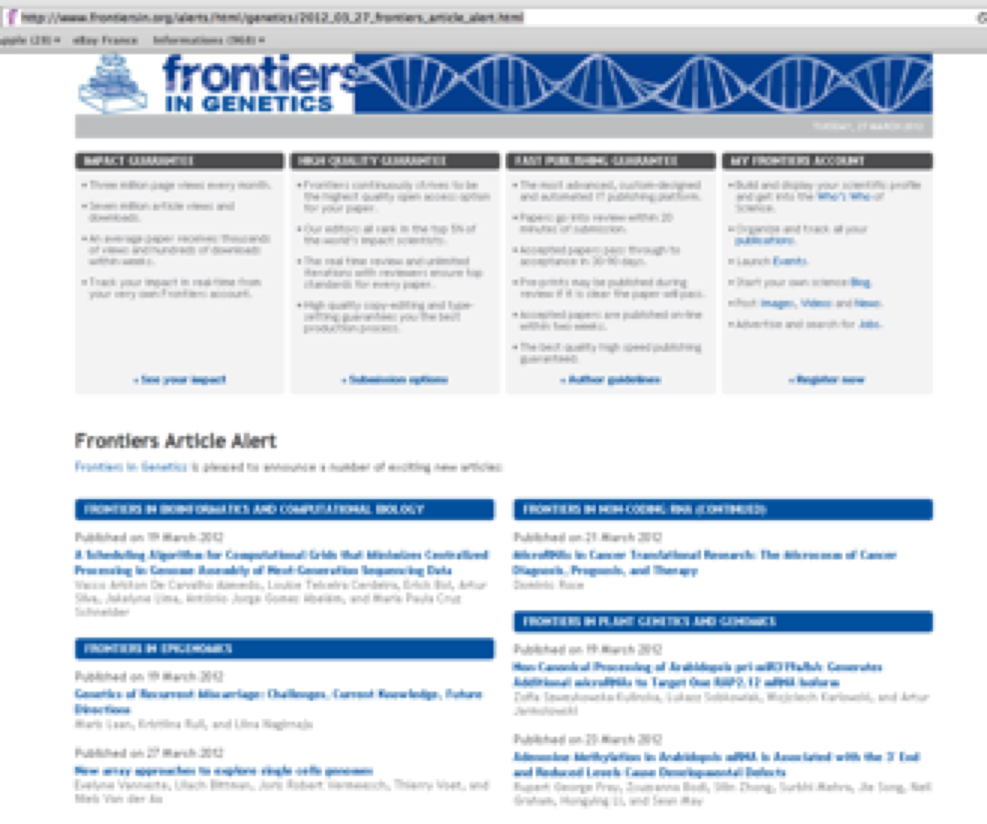
Frontiers in Genetics
http://www.frontiersin.org/alerts/html/genetics/2012_03_27_frontiers_article_alert.html

Slide 29
Scientific work evaluation

Slide 30

Bibliometrics - metrics

Slide 31
Scientific Work Evaluation: h-index
The h-index is an index that attempts to measure both the productivity and impact of the published work of a scientist.
Definition: h-index
A scientist has index h if h of [his/her] n papers have at least h citations each (the other (n − h) papers have at most h citations each).
Web of Sciences (ISI): http://en.wikipedia.org/wiki/ISI_Web_of_Knowledge
Scopus: http://en.wikipedia.org/wiki/Scopus
Google Scholar: https://scholar.google.fr

Slide 32
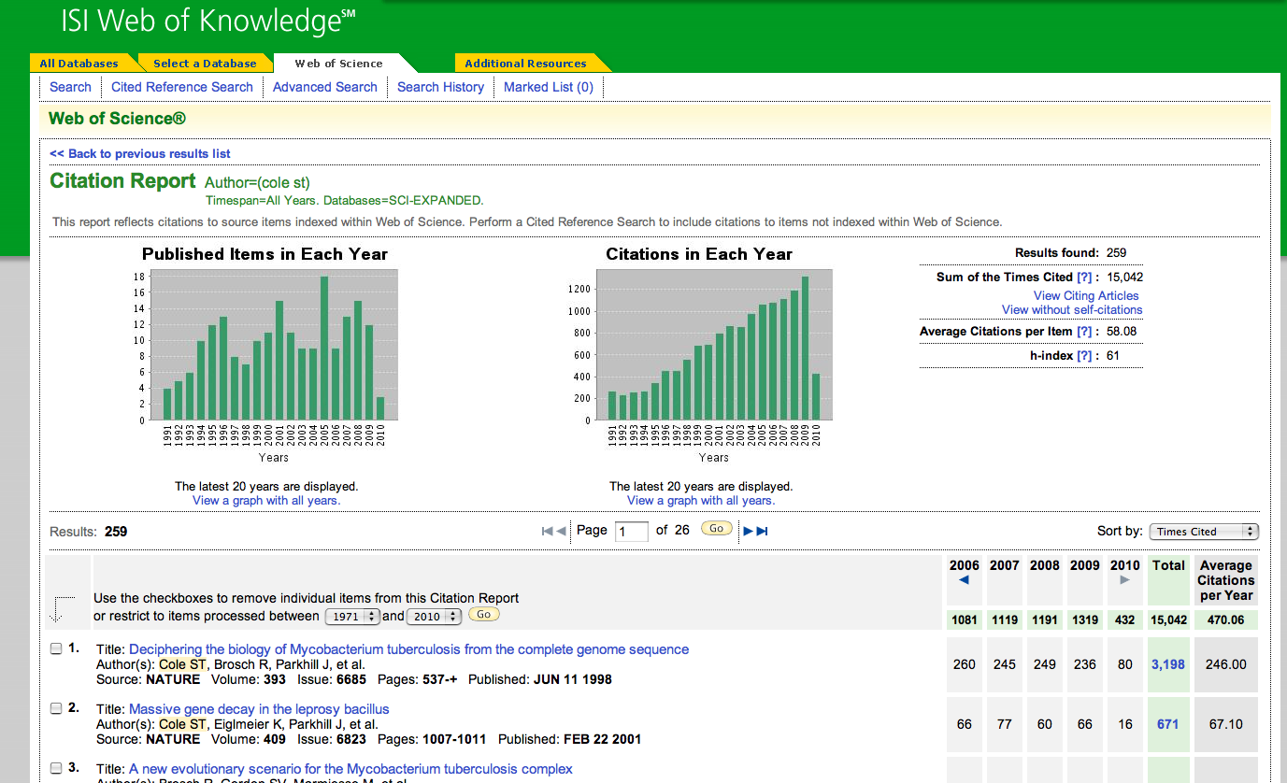
Scientific work Evaluation : h-index and citations
ISI web knowledge: http://isiwebofknowledge.com/
Citation and journal database. Requires authentication and login.

Slide 33
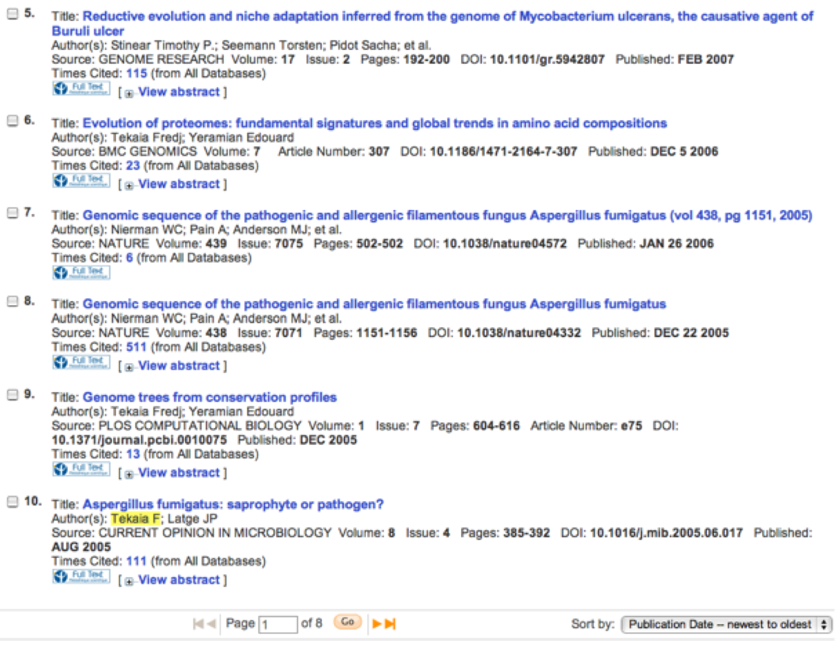
Follow up of citations of publications

Slide 34
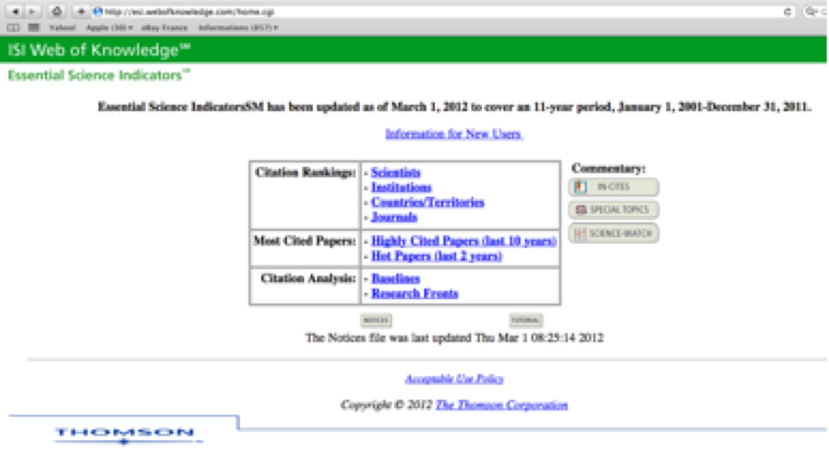
ISI Web Knowledge: Essential Science Indicators
http://esi.webofknowledge.com/home.cgi

Slide 35
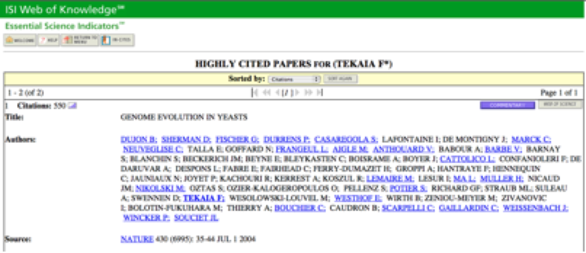
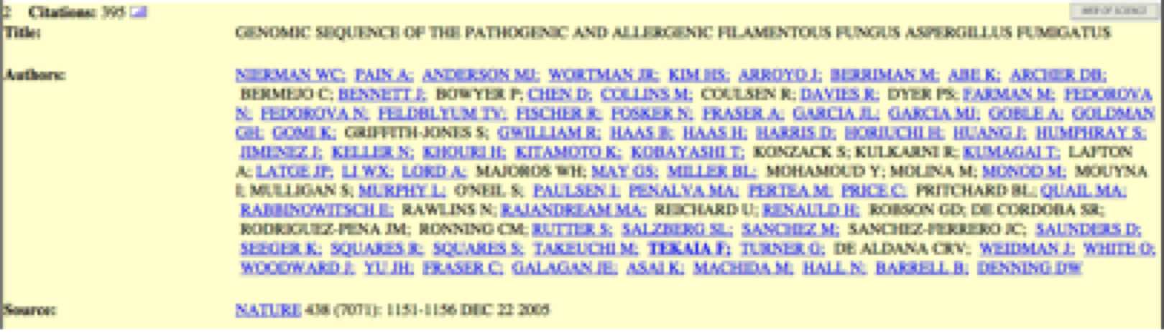
Highly Cited Papers (last 10 years)

Slide 36
Google scholar
http://scholar.google.com/

Slide 37
4. Abstracting/indexing:
There are many abstracting/indexing services.
ISI Thomson Reuters
SCOPUS
SCImago Journal & Country Rank (SJR)
US National Library of Medicine (NLM) Catalog
ProQuest (Screen shot)
HINARI (United Nation's Database)
CAB abstract (UK)
EBSCOhost (USA)
AGORA (United Nation's FAO database)
Google scholar
DOAJ
SHERPA/RoMEO (UK)
OARE (United Nations Environment Programme (UNEP), Yale University, etc.)
Ulrich's
Zentralblatt MATH
CrossRef
For more information please visit here.

Slide 38
Bibliometrics - metrics
List of papers on metrics: http://www.nature.com/news/specials/metrics/index.html
Citations analysis: the counting house:
http://www.nature.com/nature/journal/v415/n6873/full/415726a.html
We need a measured approach to metrics:
http://www.nature.com/news/we-need-a-measured-approach-to-metrics-1.17928
Bibliometrics: The Leiden Manifesto for research metrics:
http://www.nature.com/news/bibliometrics-the-leiden-manifesto-for-research-metrics-1.17351

Slide 39
SCIMAGO: http://www.scimagojr.com
Journals, countries ranking and comparisons.
• Country ranking: http://www.scimagojr.com/countryrank.php

Slide 40

Beware Predatory Journals!
Nature 549, 23–25 (07 September 2017) doi:10.1038/549023a

Slide 41
News Groups

Slide 42
News Groups
net.bio.net Mailing Lists
http://www.bio.net/biomail/listinfo/
Lists all the public mailing lists on net.bio.net.

Slide 43
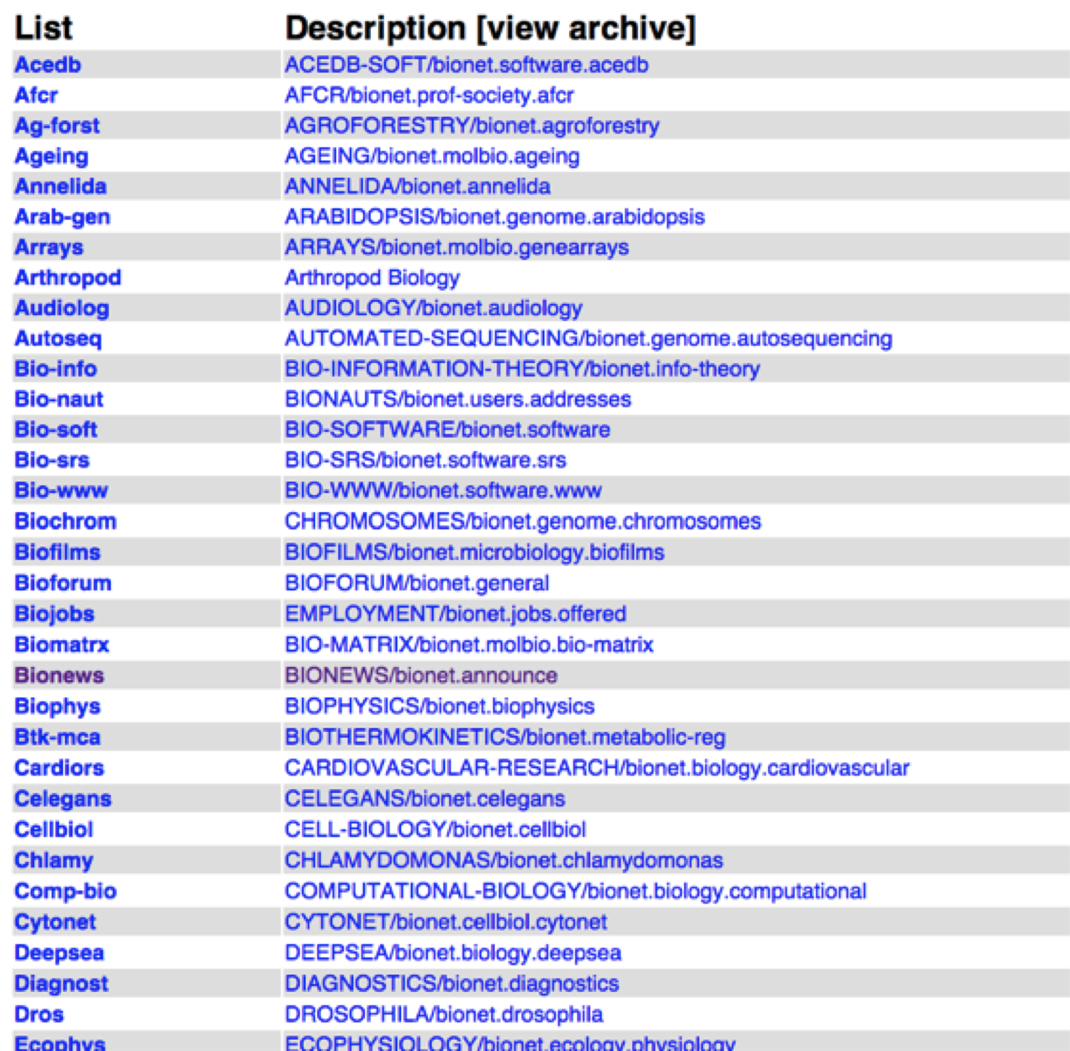
http://www.bio.net/biomail/listinfo/
Lists all the public mailing lists on net.bio.net.

Slide 44
News Groups
Bionews: http://www.bio.net/biomail/listinfo/bionews
• BIOSCI newsgroup BIONEWS / bionet.announce is for Announcements of widespread interest to biologists. (Moderated)
• To see the collection of prior postings to the list, visit the Bionews Archives: http://www.bio.net/bionet/mm/bionews/
• Subscribing to Bionews (to receive all e-mails sent to this news group)
• To post a message to all the list members, send email to bionews@net.bio.net

Slide 45
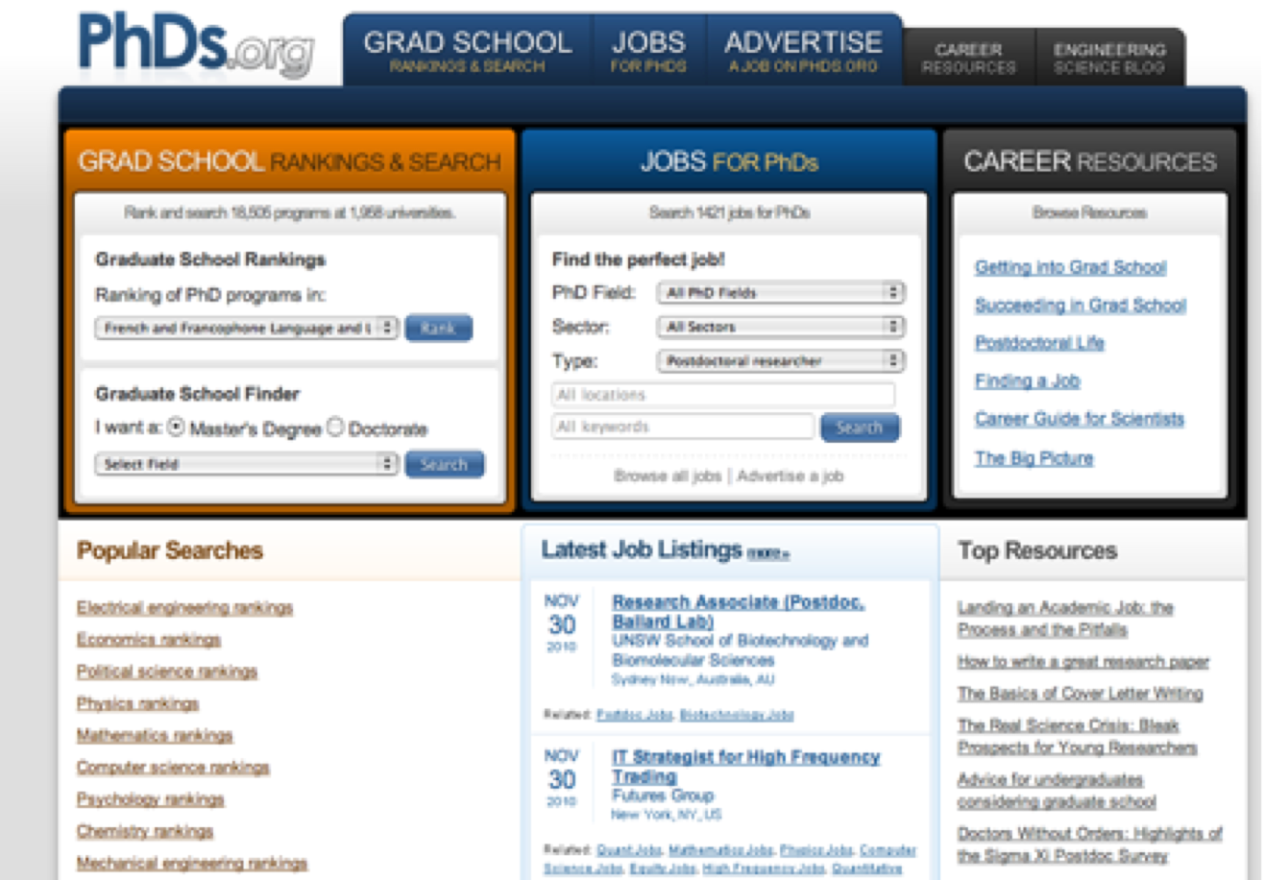
PhDs.org
http://www.phds.org/

Slide 46
Thank You

